Slide 1


Bacterial growth and bacterial genetic
Lecture 6
Prof. Dr. Munira Ch. Ismaeel
Ass. Prof. Dr. Israa AJ Ibrahim

Slide 2

Bacterial growth and bacterial genetic Lec. 6
Prof. Dr. Munira Ch. Ismaeel and Ass. Prof. Dr. Israa AJ Ibrahim

Slide 3
Microbial Growth
Microbial Growth is defined as the increase in the number of cells, which occurs by cell division.
Two Types of Asexual Reproduction in Microbes:
1)Binary Fission – (equal cell division): A cell duplicates its components and divides into two cells.

Slide 4
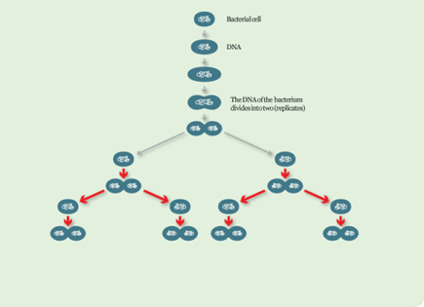
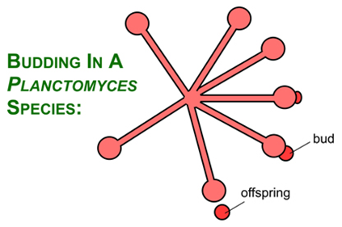
Reproduction through Binary Fission. One becomes two ... two becomes four ... four becomes eight This means in 8 hours, the number of bacteria will have risen to a colossal 16,777216!
2) Budding (unequal cell division) - A few bacteria and some eukaryotes (including yeasts) may also replicate by budding, forming a bubble-like growth that enlarges and separates from the parent cell.

Slide 5
Phases of Growth
Phases of Growth - A microbial lab culture typically passes through 4 distinct, sequential phases of growth that form the standard bacterial growth curve.

Slide 6
standard bacterial growth curve
1.Lag Phase - In the lag phase;
- organisms have adapted to a growth medium.
- the number of cells doesn't increase.
- they are metabolically active.
- grow in size, synthesize enzymes, and incorporate molecules from medium.
2.Log Phase (logarithmic or exponential phase)
- cell numbers increase exponentially.
- during each generation time, the number of cells in the
population increases by a factor of two.
-The organisms divided at their most rapid rate.

Slide 7
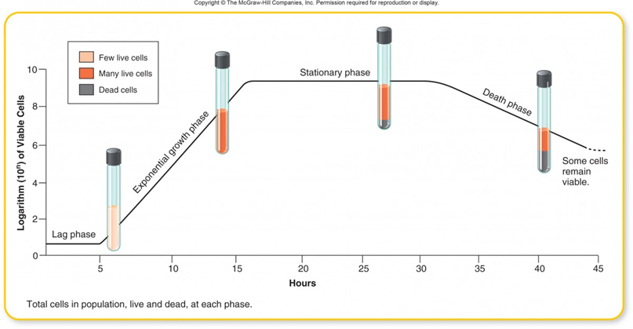
Con.-standard bacterial growth curve
3.Stationary Phase –
-Cell division decreases to a point that new cells are produced at same rate as old cell die.
-cell become smaller and synthesize components to help them survive longer periods without growing.
-some may even produce endospores
-the signal to enter this phase may have to do with overcrowding (accumulation of metabolic byproducts, depletion of nutrients, etc.).
4.Death Phase –
-In this phase, cells begin to die out.
- Death occurs exponentially, but at a low rate.
-Death occurs because cell have depleted intracellular

Slide 8
Measuring microbial growth
Direct methods
-Plate count
-Filtration
-Most probable number (MPN)
-Direct microscopic count
In Direct methods
-Turbidity
-Metabolic activity
-Dry weight

Slide 9
Bacterial Genetic
Genetics: science of heredity study of what genes are, how they carry information, how they are replicated, passed along, and how expression of the information determines characteristics of the organism.
A chromosome is circular in prokaryotes and linear in eukaryotes.
Nucleic acids (DNA & RNA) are made up of building blocks called nucleotides.
In DNA, nucleotides are arranged in a twisted double chain called a helix.

Slide 10
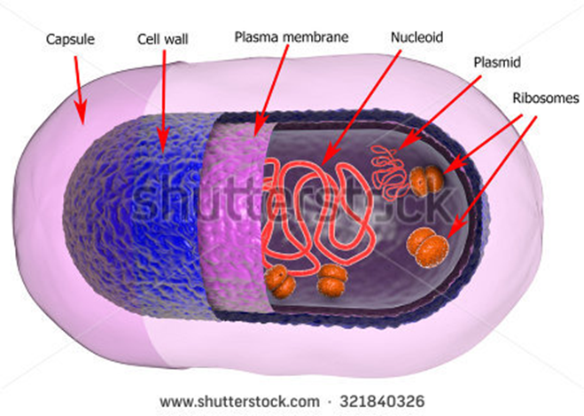
The particular nucleotide sequence spells out the “genetic code” that provides information for the synthesis of new DNA (DNA replication necessary for cell division) and for the synthesis of proteins.
A typical prokaryotic cell contains a single circular chromosome. Bacteria may also have a small, circular piece of extrachromosomal DNA called a plasmid. Human body cells, examples of eukaryotic cells, have 46 linear chromosomes.
A gene, the basic unit of heredity, is a liner sequence of DNA nucleotides that form a functional unit of the chromosome or plasmid. All information for the structure and function of an organism is coded in its genes.

Slide 11
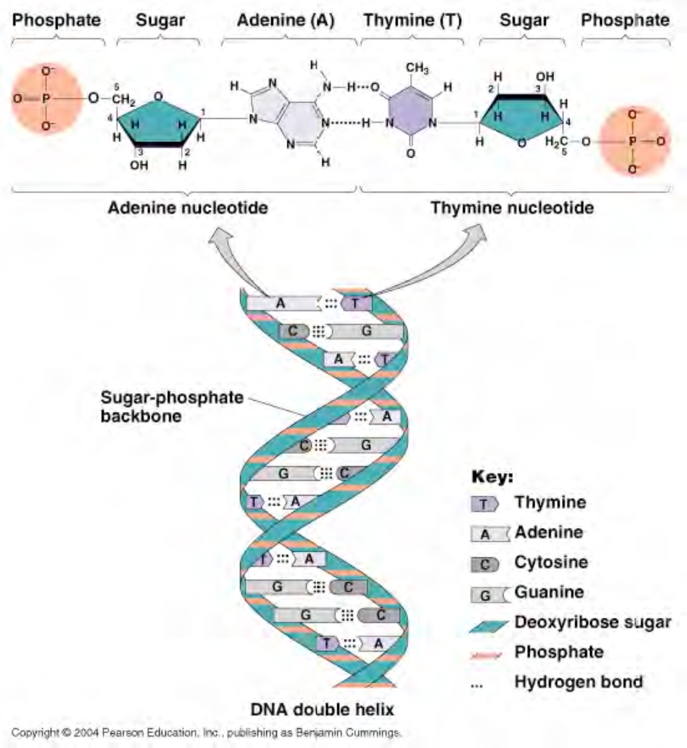
DNA are macromolecule, strands of nucleotides. The nucleotide consist of nitrogenous base, deoxyribose and phosphate.

